Slide 1


www.fatherhudsons.org.uk
Charity no. 512992

Slide 2
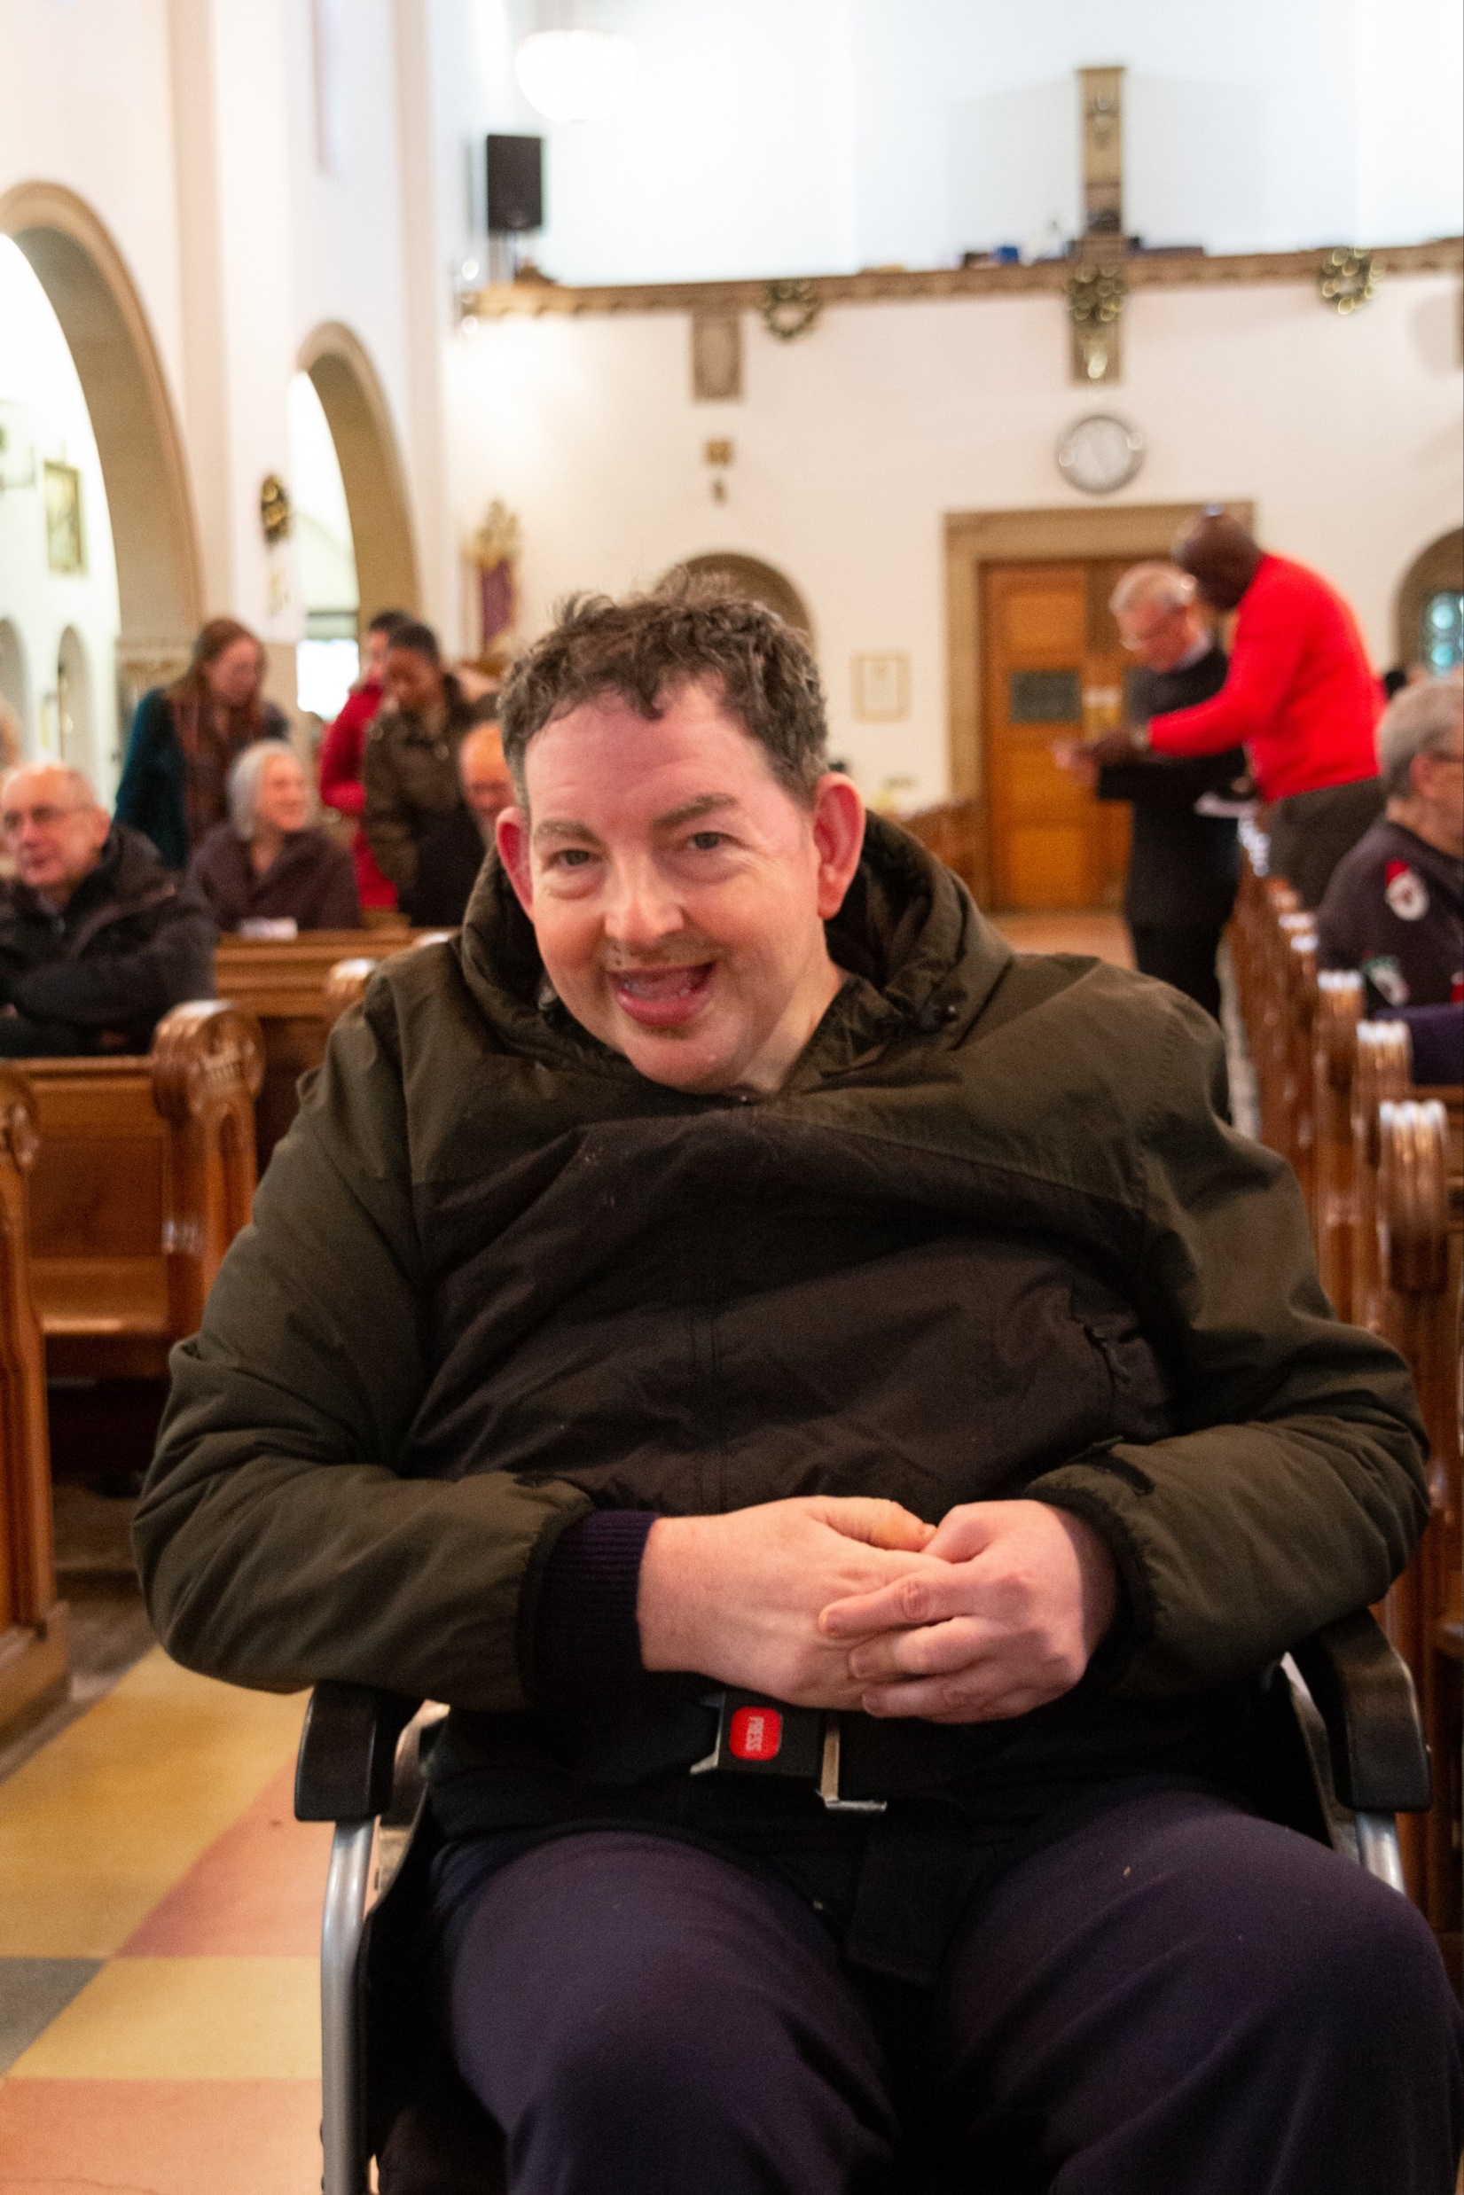
Housekeeping & Schedule
Disability
Notes:
Fr Michael

Slide 3
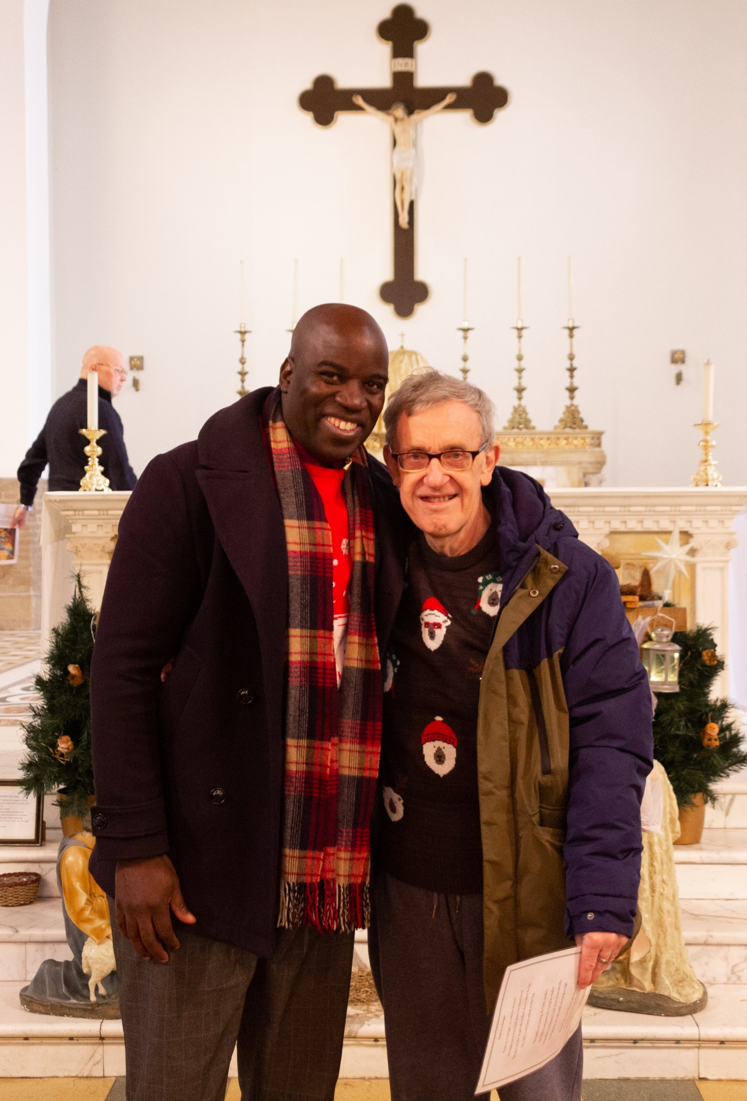
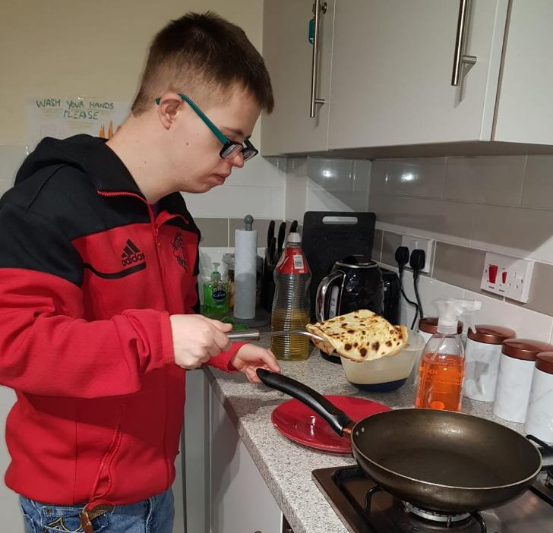
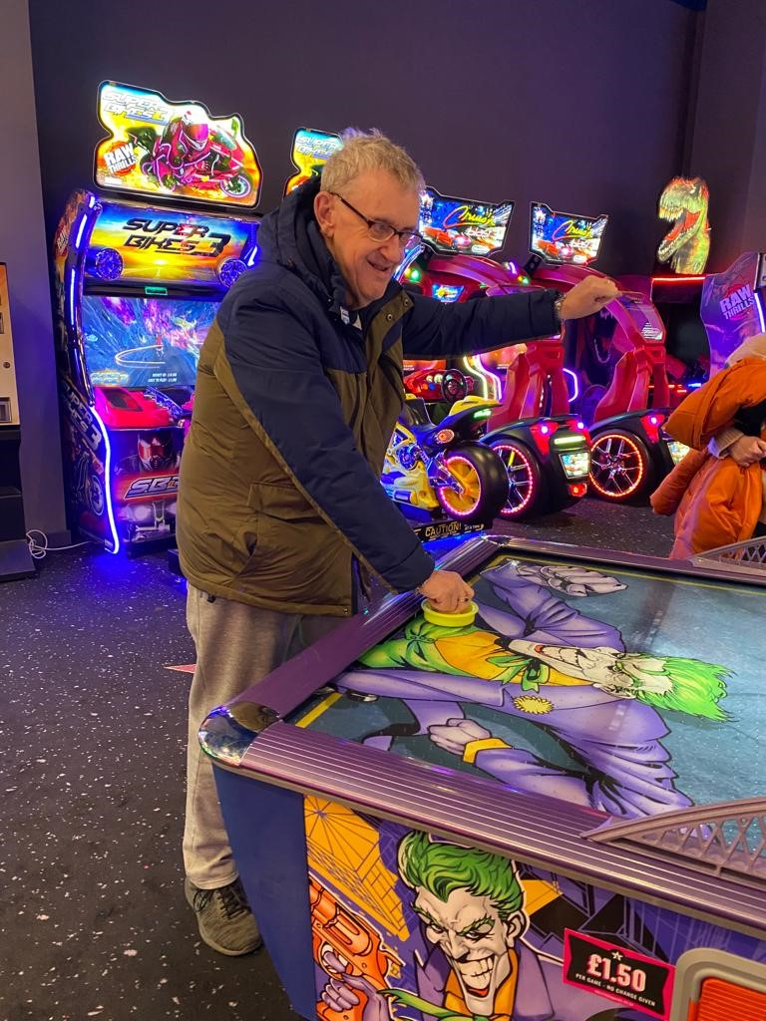
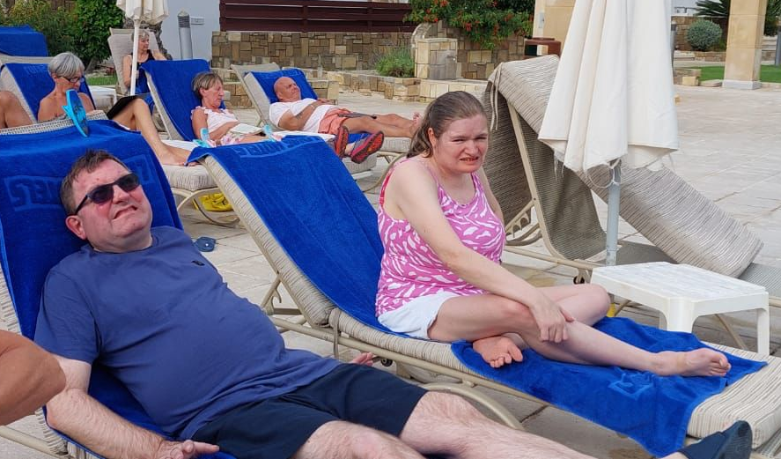
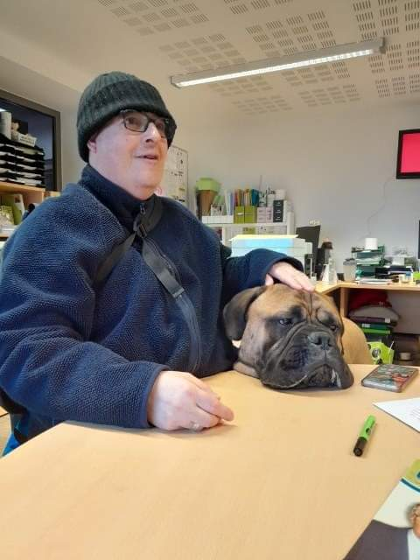
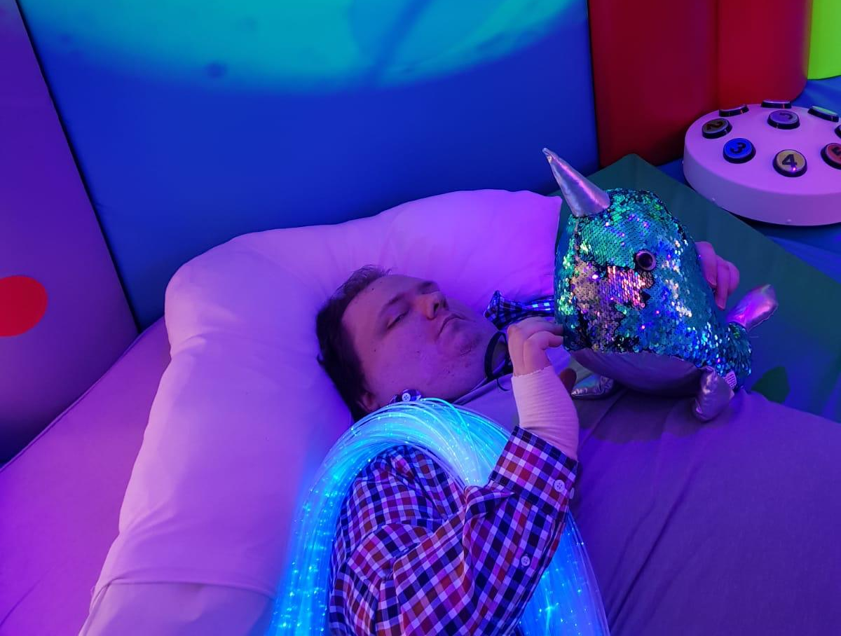
Andy Penny
Manager of Domiciliary Care and Supported Living
www.fatherhudsons.org.uk
Charity no. 512992

Slide 4
Any questions?
With Andy
www.fatherhudsons.org.uk
Charity no. 512992

Slide 5

The Liturgy
Deacon Mark
dcn.mark.paine@rcaob.org.uk
www.fatherhudsons.org.uk
Charity no. 512992

Slide 6
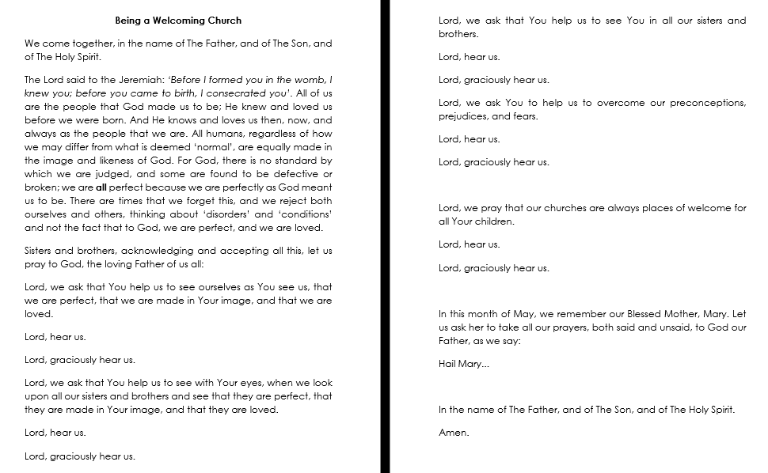
The Liturgy
Deacon Mark
dcn.mark.paine@rcaob.org.uk
www.fatherhudsons.org.uk
Charity no. 512992

Slide 7

Archdiocese of Birmingham
Nuneaton Catholic Disability Fellowship
Ken Haywood
Chairperson: Michael Broadaway Treasurer: Helen Robinson Secretary: Ken Haywood
21 Hamlet Close, Nuneaton CV11 6NR
024 7632 6566 trepsa1@hotmail.com
Formerly: Catholic Handicapped Children’s Fellowship. Formerly: Catholic Handicapped Fellowship. Formerly: Nuneaton & District Catholic Fellowship
www.fatherhudsons.org.uk
Charity no. 512992

Slide 8


Sunday Friends Group
Mary Drozd
www.fatherhudsons.org.uk
Charity no. 512992

Slide 9
Hand in Hand
Julie FitzSimons
julia.fitzsimons@gmail.com
www.fatherhudsons.org.uk
Charity no. 512992

Slide 10
Guidelines for parishes on Autism
Deacon Mark
dcn.mark.paine@rcaob.org.uk
www.fatherhudsons.org.uk
Charity no. 512992

Slide 11
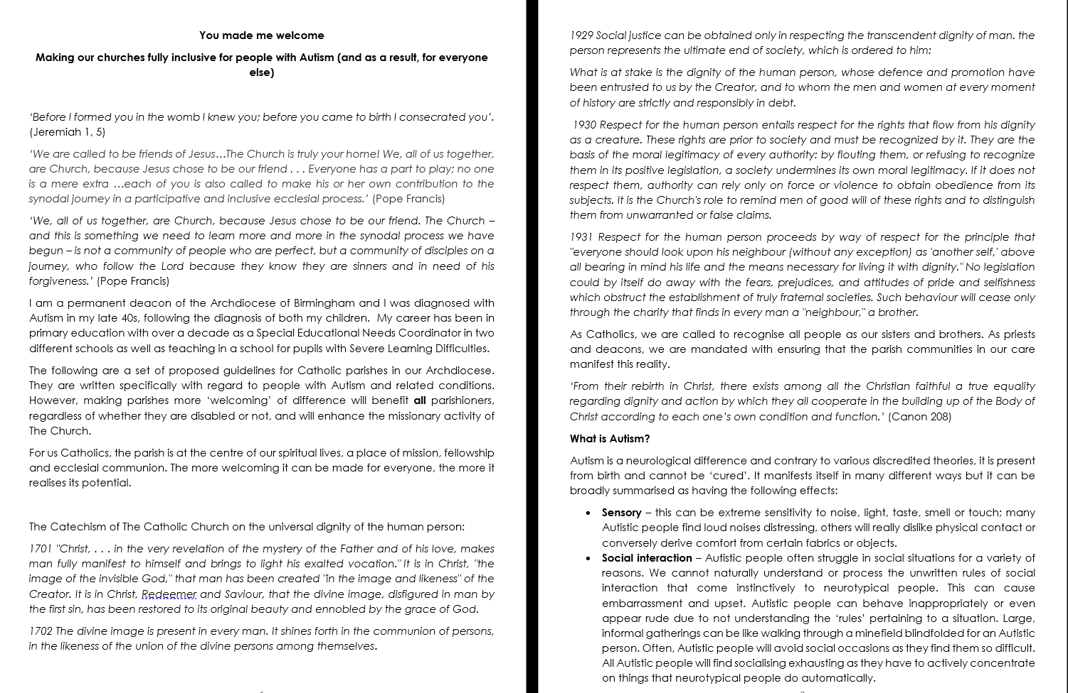
The Liturgy
Deacon Mark
dcn.mark.paine@rcaob.org.uk
www.fatherhudsons.org.uk
Charity no. 512992

Slide 12
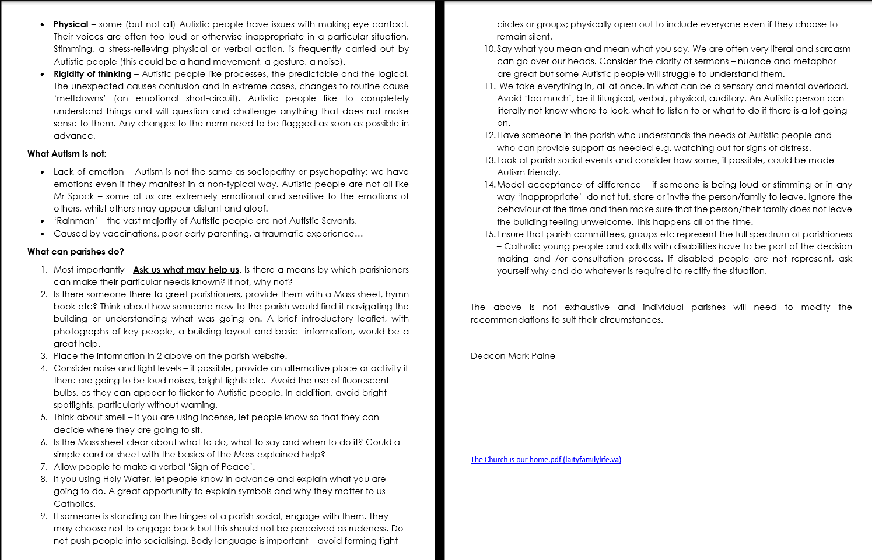
The Liturgy
Deacon Mark
dcn.mark.paine@rcaob.org.uk
www.fatherhudsons.org.uk
Charity no. 512992

Slide 13
Experiences, as a parent of children with additional needs
Gareth O’Keefe
www.fatherhudsons.org.uk
Charity no. 512992

Slide 14
Any questions?
With Andy
www.fatherhudsons.org.uk
Charity no. 512992

Slide 15
Personal call to action!
www.fatherhudsons.org.uk
Charity no. 512992

Slide 16
Thank you for attending
Andy Penny- Domiciliary Care Manager
andrew.penny@fatherhudsons.org.uk
01675 434 026
Deacon Mark
dcn.mark.paine@rcaob.org.uk
Ken Haywood - Archdiocese of Birmingham Nuneaton Catholic Disability Fellowship
trepsa1@hotmail.com
Mary Drozd – Sunday Friends Group
Email?
Julie FitzSimons- Hand in Hand
julia.fitzsimons@gmail.com
Gareth O’Keefe – Parent
gazok79@gmail.com
www.fatherhudsons.org.uk
Charity no. 512992

Slide 17

We hope you can join us for our next session focusing on Homelessness on Monday 19 ^{th} June
Get in touch with us at:
www.fatherhudsons.org.uk | 01675 434000 | enquiries@fatherhudsons.org.uk
Find us on social media @FatherHudsons
www.fatherhudsons.org.uk
Charity no. 512992

